Slide 1
Recap Typescript Assignment http://www.typescriptlang.org/docs/handbook/compiler-options.html

Slide 2
Angular Fundamental
Md. Abul Hasan
Software Engineer, SELISE
Email: abul.hasan@selise.ch
Skype: raju.hasan09

Slide 3
In this section……
What & Why Angular?
Angular Version History
Basic Structure of Angular App.
Naming Convention
Components
Displaying Data & Event handling
Templates
Directives
Template-driven forms
Services
Routing and navigation
Component Communications

Slide 4
What & Why Angular?
A framework for building client applications in HTML, CSS, and JS/TS.
What & Why Angular?
JS/jQuery not?
Hard to test
Maintain difficult
Angular, React, Vue
Benefits
Clean Structure
Re-usable code
More testable
Angular makes your life easier to build Client application.

Slide 5
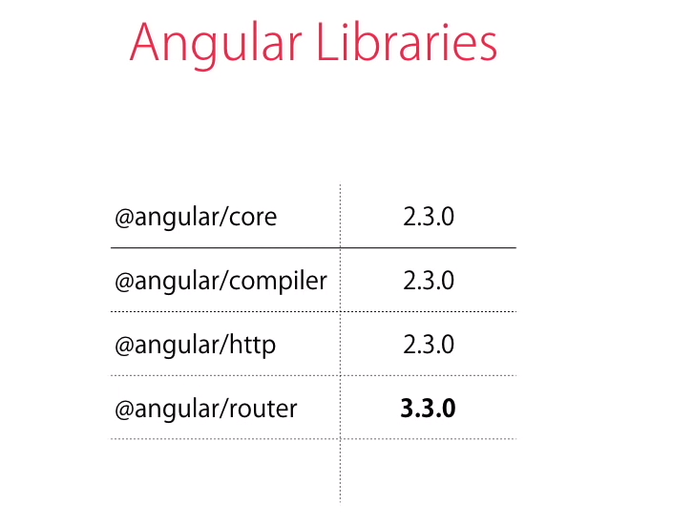
Angular Version History
AngularJs/Angular2/Angular4
2/2.1/2.2/2.3/4

Slide 6
Project Setup
ng new hello-world
Every app have at least one module and one component
Basic Structure of Angular App
Web pack : Build automation tool

Slide 7
Naming Convention
Angular Style Guide
File Name: lowercase
Module: app.module.ts
Component: app.component.ts
Template: app.component.html
Styles: app.component.css/scss
Directive: app.directive.ts
Separate file names with dots and dashes
Folder Name: lowercase
If multiple word then word append with – like app-student
Component: Pascal Naming Convention & Suffix Component
Service: Pascal Naming Convention & Suffix Service
Directive: Pascal Naming Convention & Suffix Directive
Class: Pascal Naming Convention ex: ExceptionService
Constant: UPPER(SNAKE_)CASE/camelCase
Property & method: camelCase

Slide 8
Single Responsibility
Angular Style Guide Continue…
Create Service with Single Responsibility
Small Function
Per file have 400 line codes
Per function have 75 line codes

Slide 9
Components
Component encapsulate Data, HTML Template, Logic.
Every app has one component and tree of component.
Create a component
Register it in a module
Add an element in an HTML mark-up

Slide 10
Others
Template
Directive
Service
Routing and navigation

Slide 11
Component Communication
Input
Output
Event Emitter
Behavior Subject

Slide 12
Home Work
Create a Data table app which show a set of Persons data.
Data table have sorting, paging which not client side.
Per page by default show 10 collections.
Data table app must be reusable.
Navigation have 2 option [User, Person].
If click Person, then route change to /person.
Inside Person there should be present Person List and Add New Button.
List have Edit and Delete button.
When click button it’s redirect to person/create route.

Slide 13
Continue…
Person have below filed:
FirstName (required, min-3, max-50)
LastName (optional, min-3, max-50)
DOB (Date picker) (required, max-current-date)
Country (Dropdown) (required)
Gender (Radio button) (required)
Email (email validation) (required, max-50)
Phone (phone validation) (optional)
If Delete button clicked then a modal open with message Are you sure, you want to delete this person?
In top navigation bar show counter of person. If a new person added, then counter increase and if deleted then counter decrease.

